Slide 1

Java Collections

Slide 2
Outline
Java Collections Framework – Overview
Collection Interface
List Interface
ArrayList Class
ArrayList Iteration Using for-each Loop

Slide 3
Java Collections Framework – Overview
Java Collections Framework (JCF) stores groups of objects
Overcomes fixed-size limitation of arrays
Provides ready-made data structures
Improves code reusability and readability
Located in java.util package

Slide 4
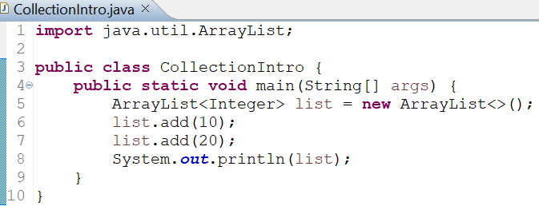

Example: Collections Framework
OUTPUT
Creates a dynamic list of integers
Adds elements using add()
Prints the entire collection

Slide 5
Collection Interface
Root interface of the Collections Framework
Defines basic operations like add and size
Cannot be instantiated directly
Enables polymorphic behavior
Implemented by List, Set, and Queue

Slide 6
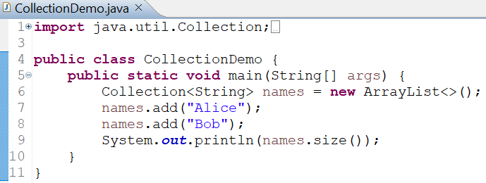

Example: Collection Interface
OUTPUT
Uses Collection reference
Stores string values
Prints number of elements

Slide 7
List Interface
Ordered collection
Allows duplicate elements
Index-based access
Maintains insertion order
Common implementations: ArrayList, LinkedList

Slide 8
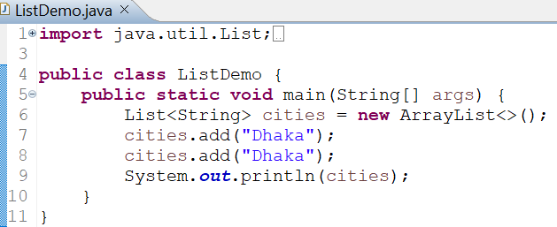

Example: List Interface
OUTPUT
Demonstrates duplicate values
Shows order preservation
Prints list contents

Slide 9
ArrayList Class
Implements List interface
Uses resizable array internally
Allows random access
Faster read operations
Widely used in practice

Slide 10
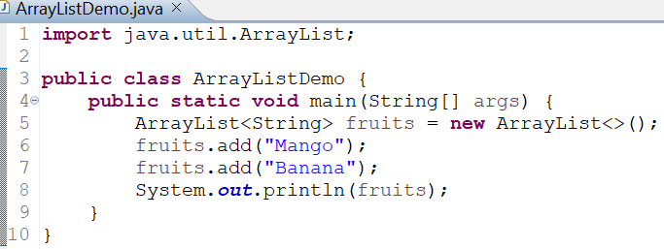

Example: ArrayList Class
OUTPUT
Creates an ArrayList
Adds string elements sequentially
Automatically resizes
Prints stored items

Slide 11
ArrayList Class: Accessing Elements
Elements accessed using index
Index starts from 0
get() retrieves value
Throws error for invalid index
Useful for random access

Slide 12
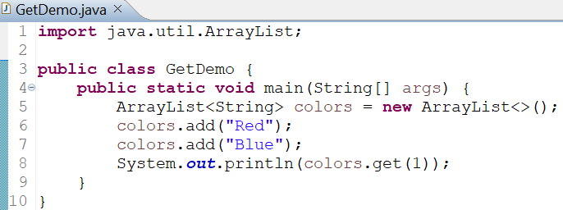
Example: ArrayList Class
OUTPUT
Stores color names
Retrieves the second element
Prints accessed value

Slide 13
ArrayList Class: Removing Elements and Size
remove()
Deletes elements
Can remove by index or value
Remaining elements shift automatically
Reduces list size
Useful for updates
size()
size() returns element count
Reflects the current list state
Updates after add/remove
Useful for loops

Slide 14
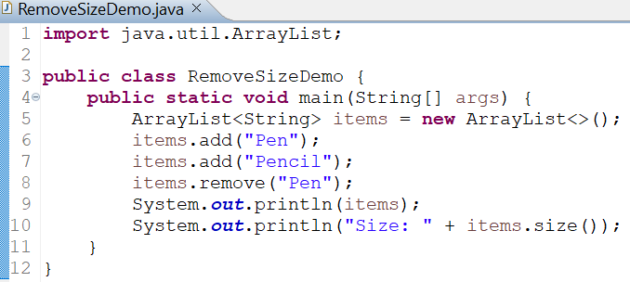

Example: ArrayList Class
OUTPUT
Removes an element by value
Updates list automatically
Prints remaining items and the current size of the ArrayList

Slide 15
Iteration Using for-each Loop
Simplest way to traverse collections
No index needed
Improves readability
Works with all collections
Read-only traversal

Slide 16
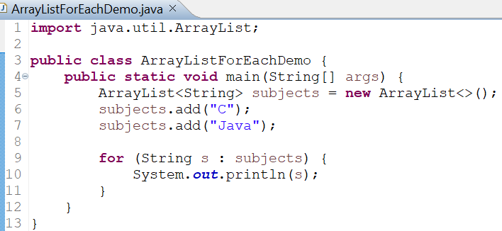

Example: Iteration Using for-each Loop
OUTPUT
Iterates over the list
Prints each element
Demonstrates enhanced loop

Slide 17
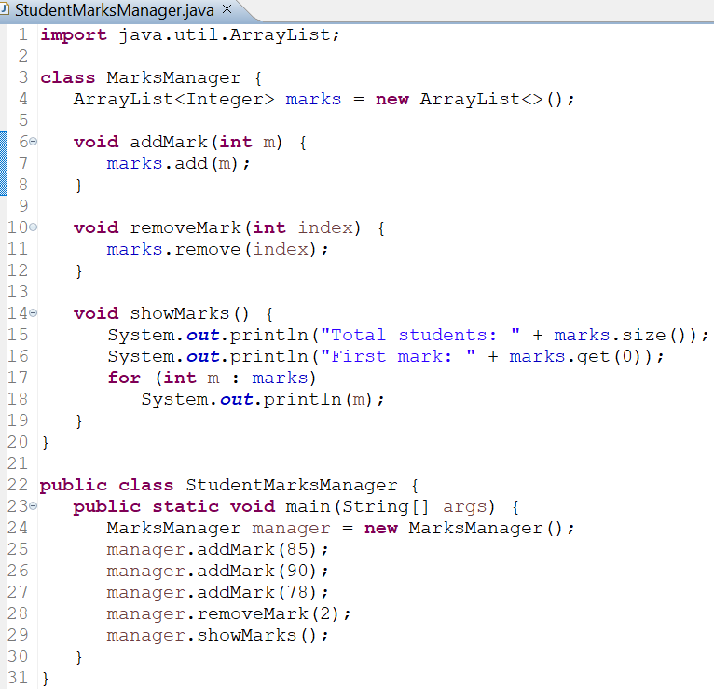
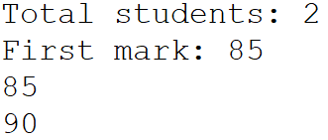
Practical Program using ArrayList
OUTPUT
This program demonstrates the following:
Demonstrates encapsulation using a class
Separates data management from program execution
Demonstrates dynamic data storage
Uses index-based access and iteration
Shows realistic use of ArrayList inside a class

